Slide 1
Installation of Visual Studio & IIS

Slide 2
Visual Studio
Visual Studio is an Integrated Development Environment(IDE) developed by Microsoft to develop GUI(Graphical User Interface), console, Web applications, web apps, mobile apps, cloud, and web services, etc. With the help of this IDE, you can create managed code as well as native code. It uses the various platforms of Microsoft software development software like Windows store, Microsoft Silverlight, and Windows API, etc. It is not a language-specific IDE as you can use this to write code in C#, C++, VB(Visual Basic), Python, JavaScript, and many more languages.
Recent iterations of the program have allowed for integration with GitHub and Microsoft’s own Azure cloud computing service.

Slide 3
Installation of Visual Studio 2022 Community Edition

Slide 4
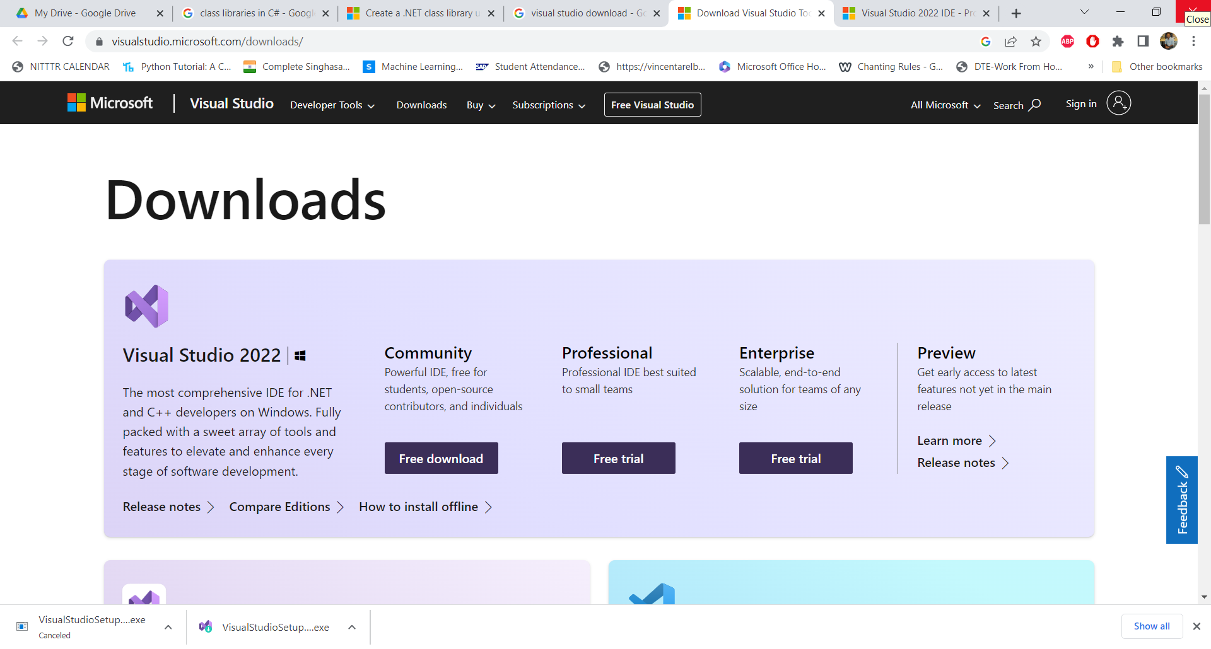

Slide 5
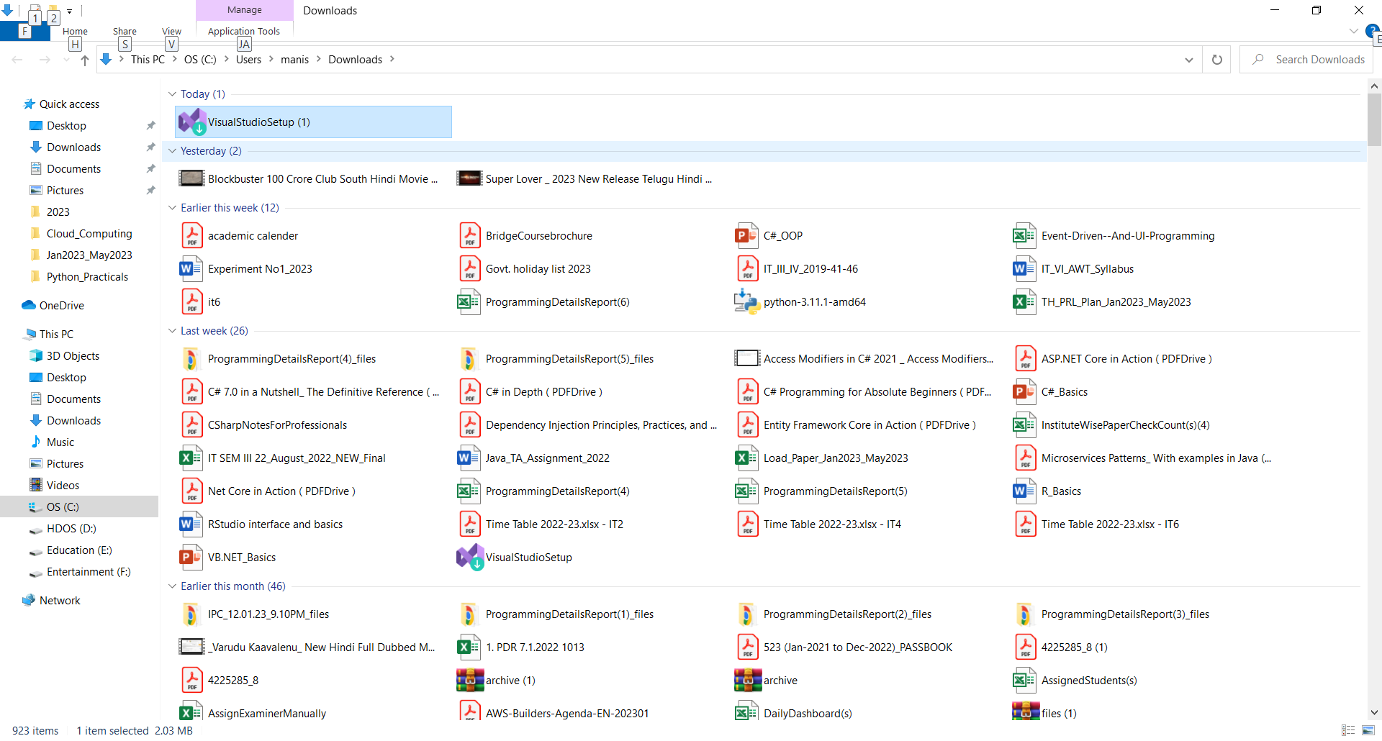

Slide 6
The Program installer will ask for your permission to install the app.

Slide 7
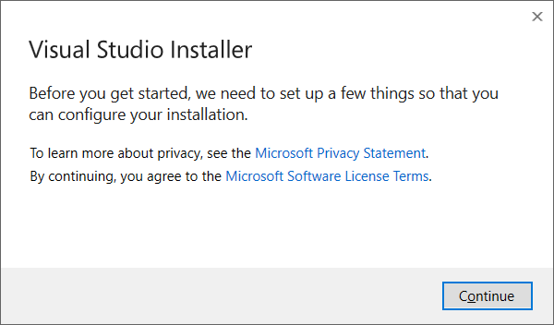

Slide 8
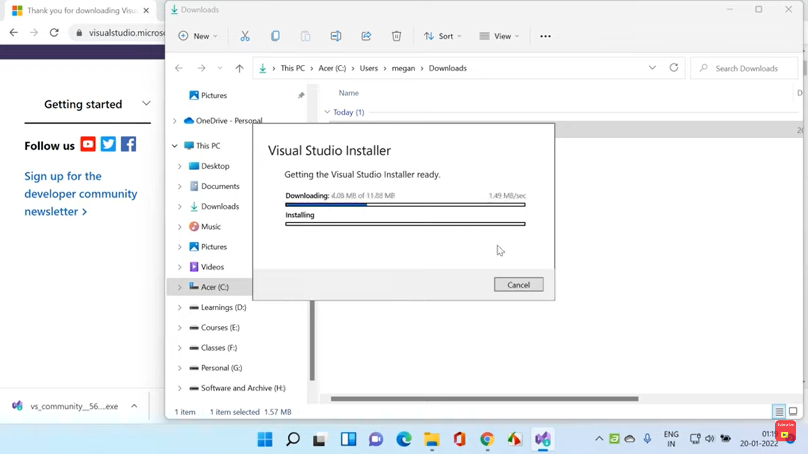

Slide 9
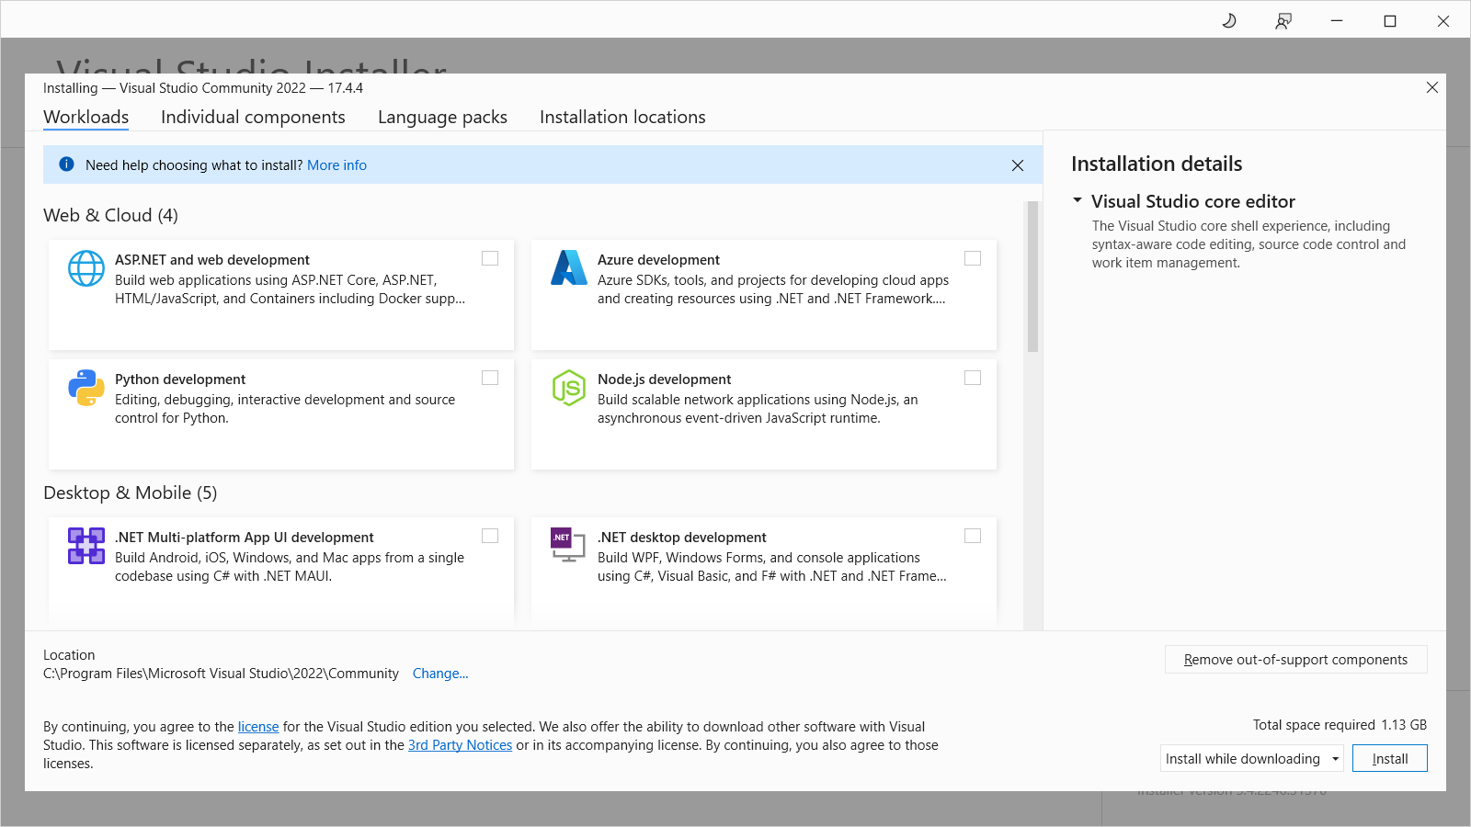

Slide 10
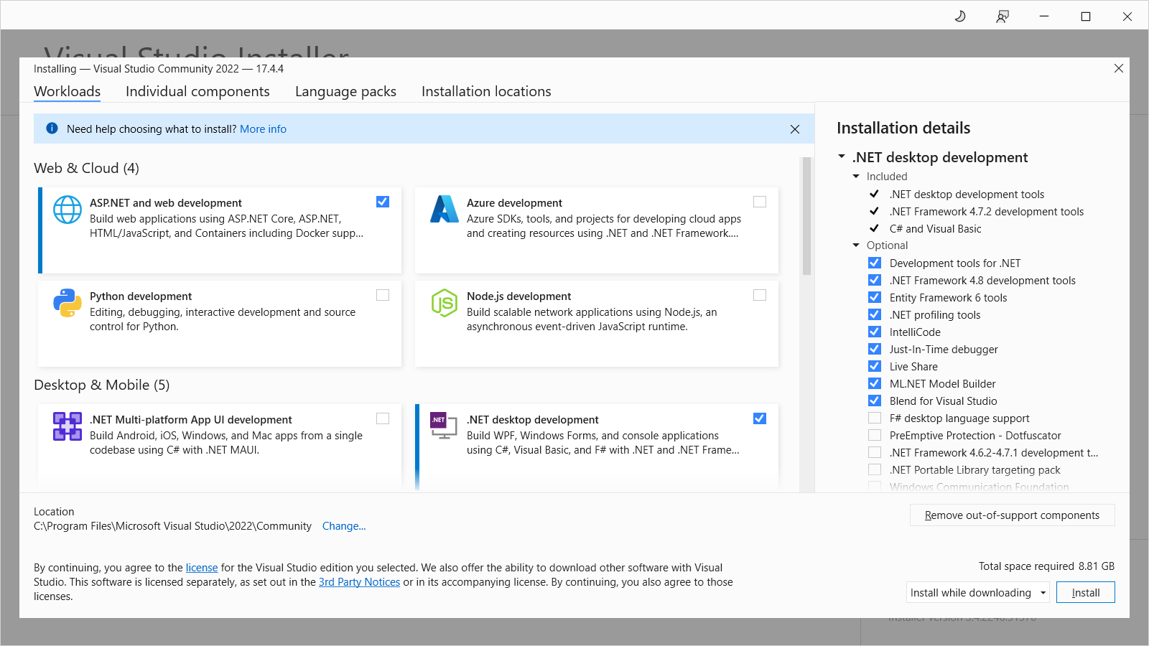
Select ASP.NET & .NET desktop development options

Slide 11
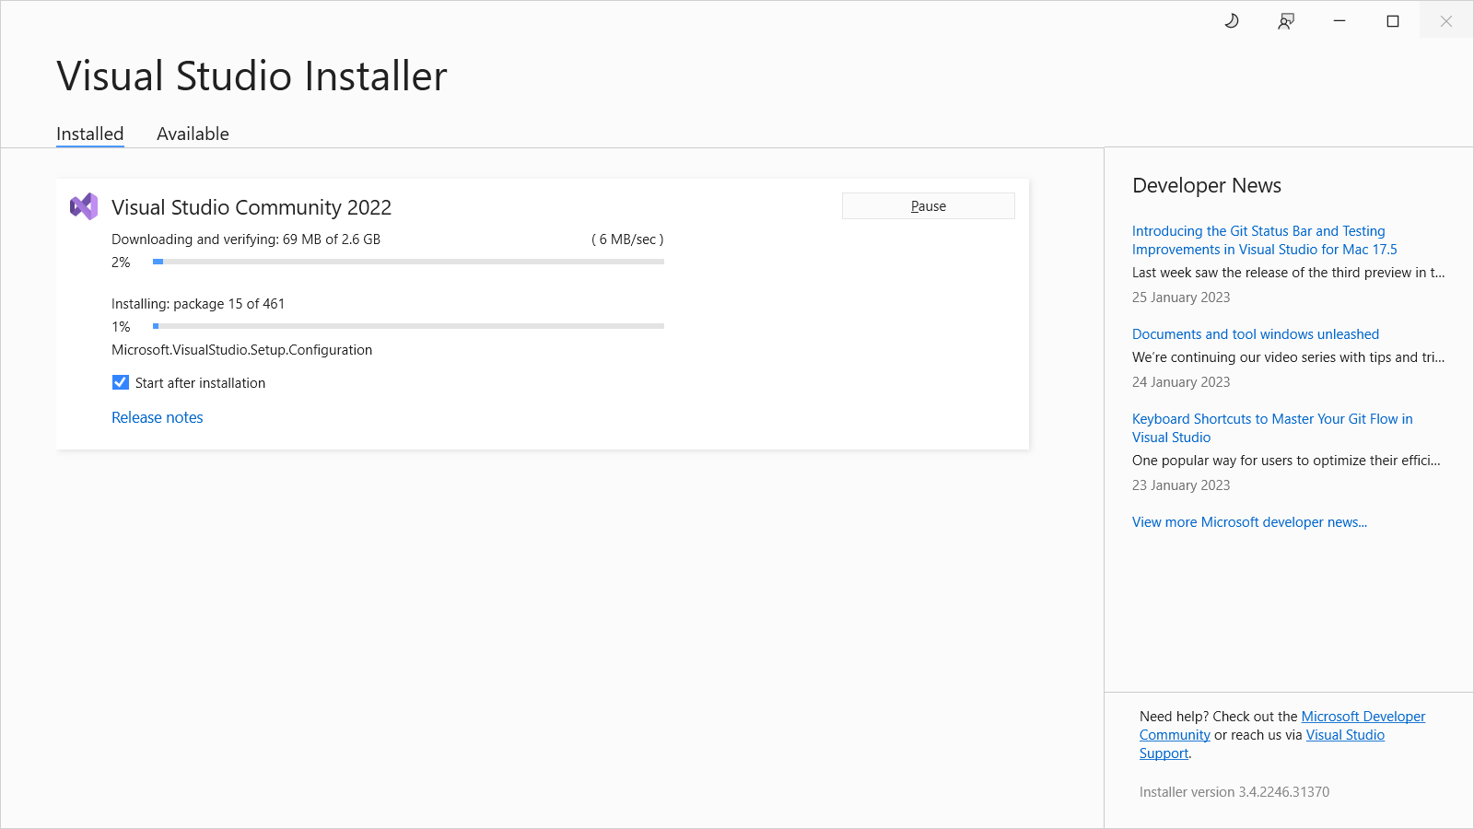

Slide 12
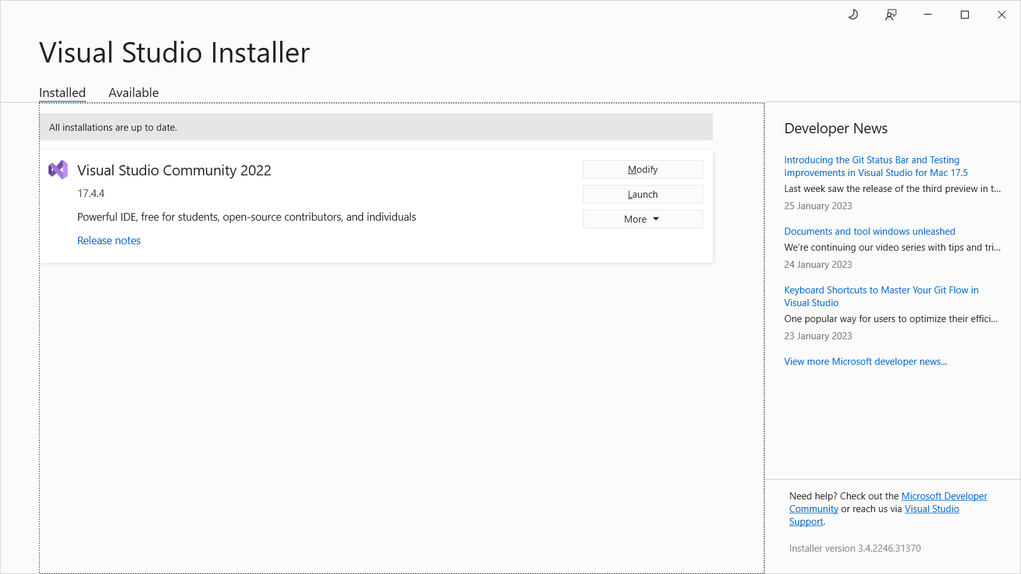
Application will be launched immediately after installation. If not, click on Launch button

Slide 13
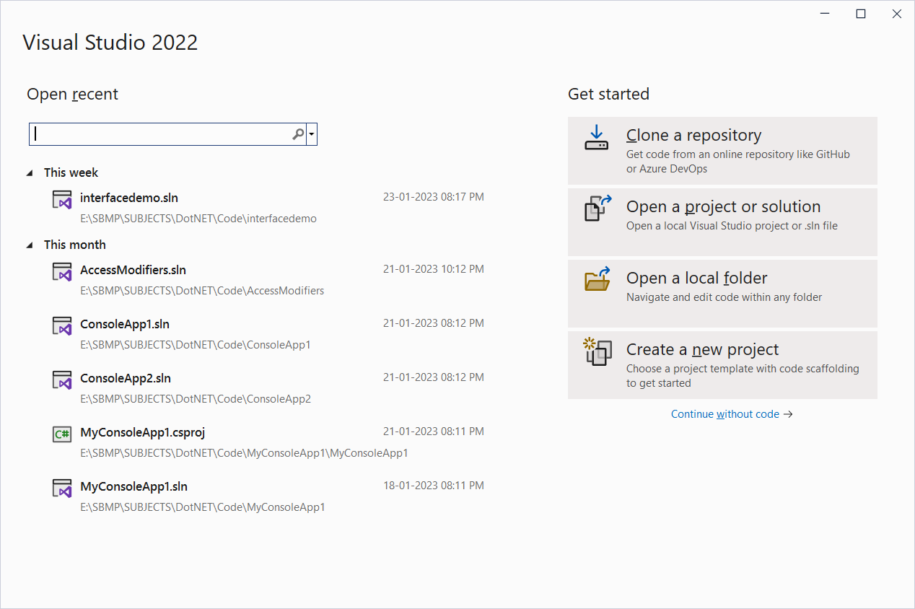
Click on “Create a new project” button

Slide 14
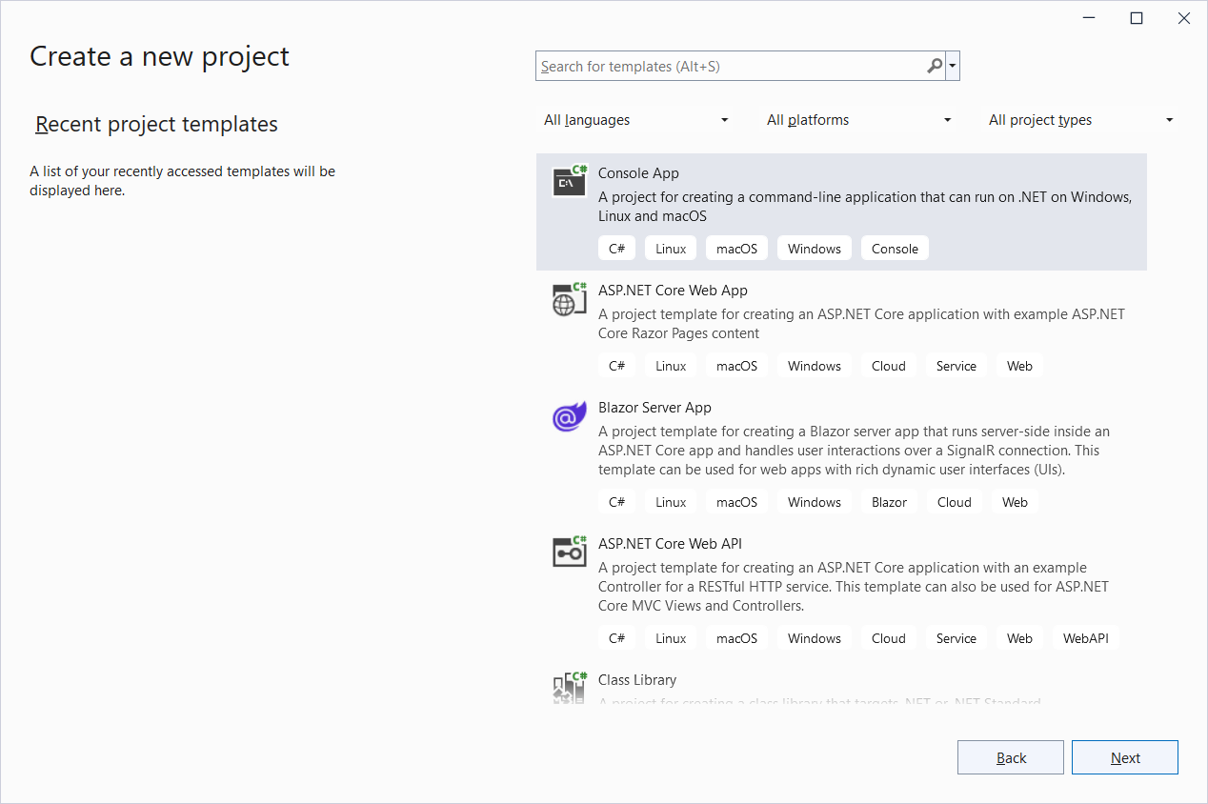
We can select language, platform and project type

Slide 15
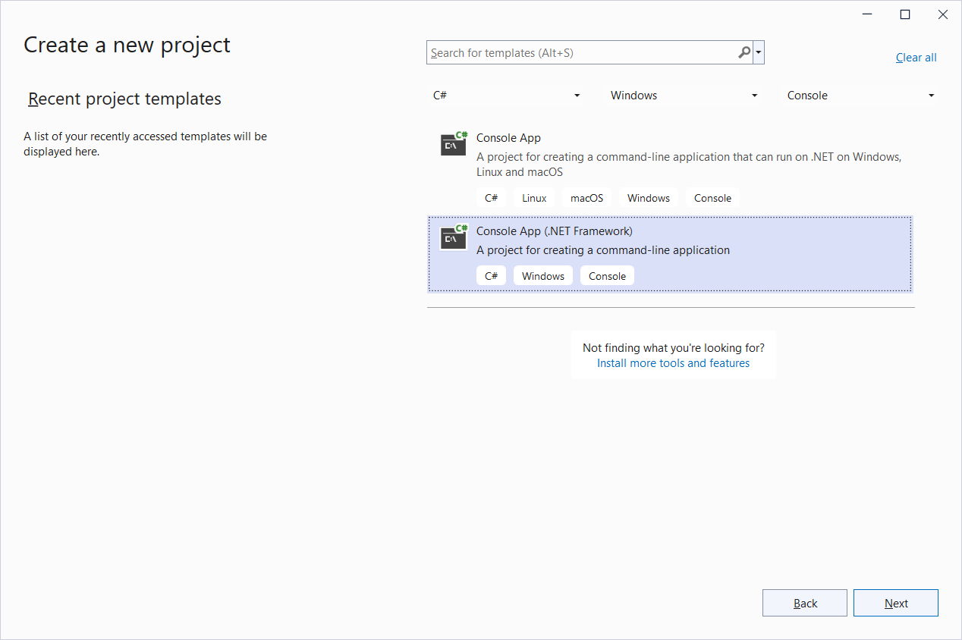
Select “Console App(.NET Framework”

Slide 16
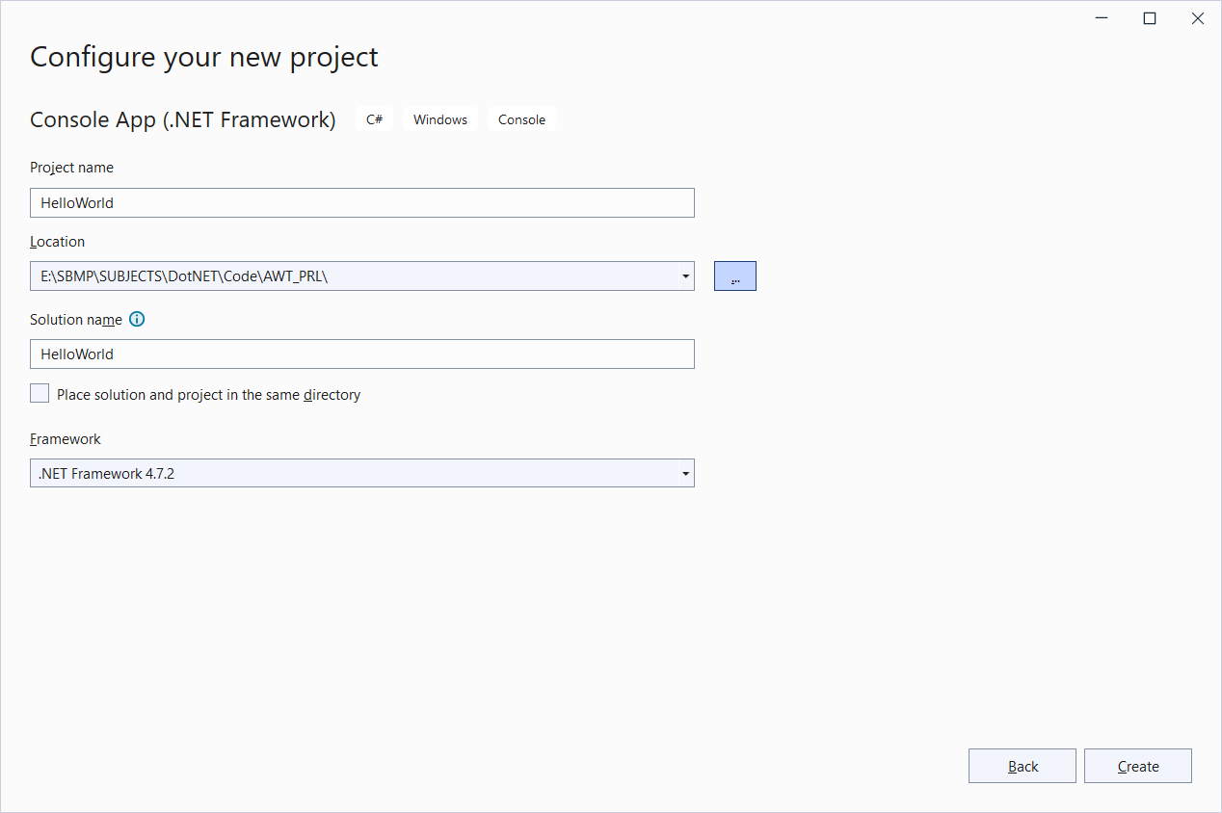
Write the name of Project and specify local path

Slide 17
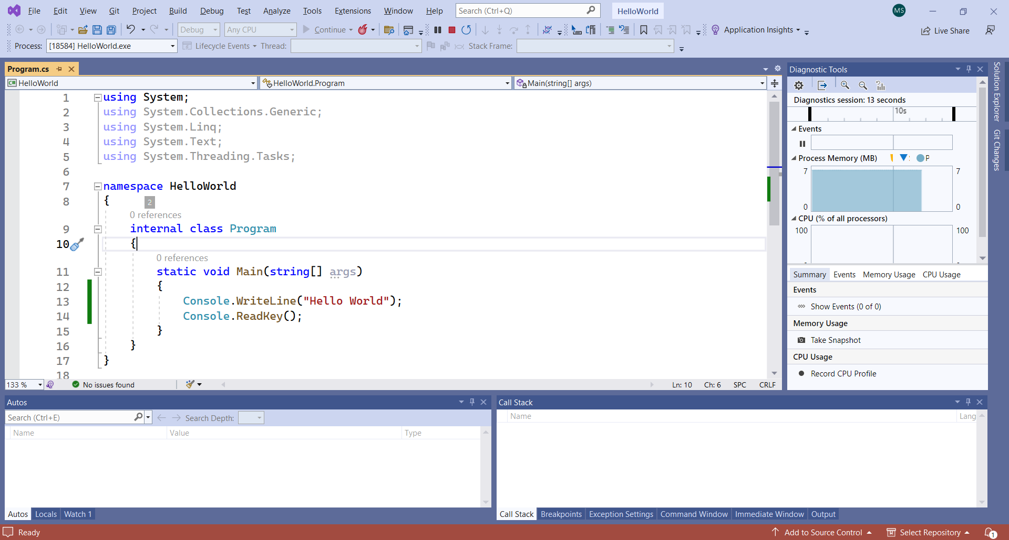
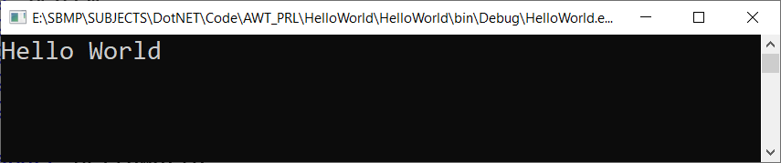
Click on Run button

Slide 18
Hello World Program
using System;
using System.Collections.Generic;
using System.Linq;
using System.Text;
using System.Threading.Tasks;
namespace HelloWorld
{
internal class Program
{
static void Main(string[] args)
{
Console.WriteLine("Hello World");
Console.ReadKey();
}
}
}
Note: We have to write readkey() or readline() method so CMD will wait to show the outcome otherwise CMD will get disappeared immediately.

Slide 19
Installation of IIS (Internet Information Services)

Slide 20
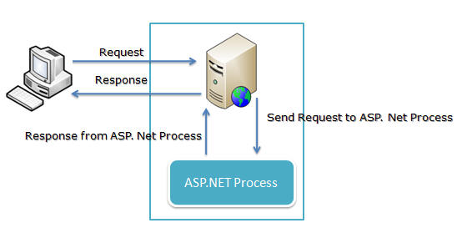
Internet Information Server
Internet Information Server (IIS) is one of the most popular web servers from Microsoft that is used to host and provide Internet-based services to ASP.NET and ASP Web applications. A web server is responsible for providing a response to requests that come from users. When a request comes from client to server IIS takes that request from users and process it and send response back to users.

Slide 21
1. On the Start page, click the Control Panel tile.
2. In Control Panel, click Programs, and then click Turn Windows features on or off.
3. In the Windows Features dialog box, click Internet Information Services to install the default features.
4. Expand the root-level item Internet Information Services, expand World Wide Web Services. Expand the Application Development Features node and click ASP.NET 4.5 to add the features that support ASP.NET. (If you installed .NET 3.5, select ASP.NET 3.5 also.) The following additional features are automatically selected:
.NET Extensibility 4.5
ISAPI Extensions
ISAPI Filters
.NET Extensibility 3.5 (If ASP.NET 3.5 was selected)
Click OK to close the Windows Features dialog box.

Slide 22
To verify that IIS installed successfully, type the following into a web browser:
http://localhost
The default IIS Welcome page is displayed.

Slide 23
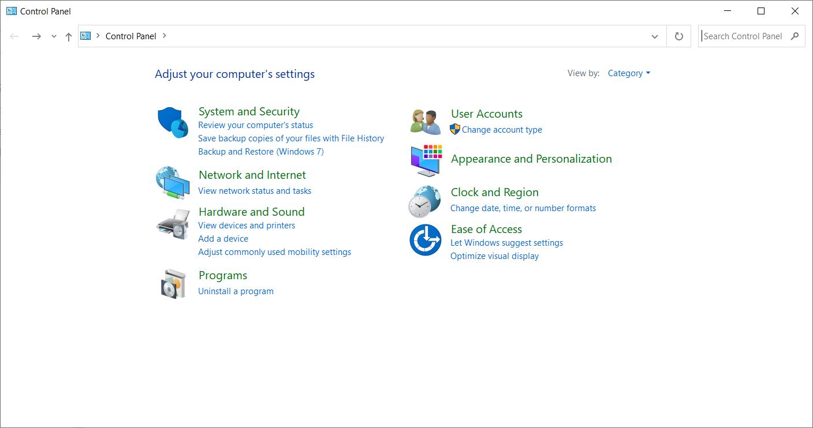
Click on “Programs”

Slide 24
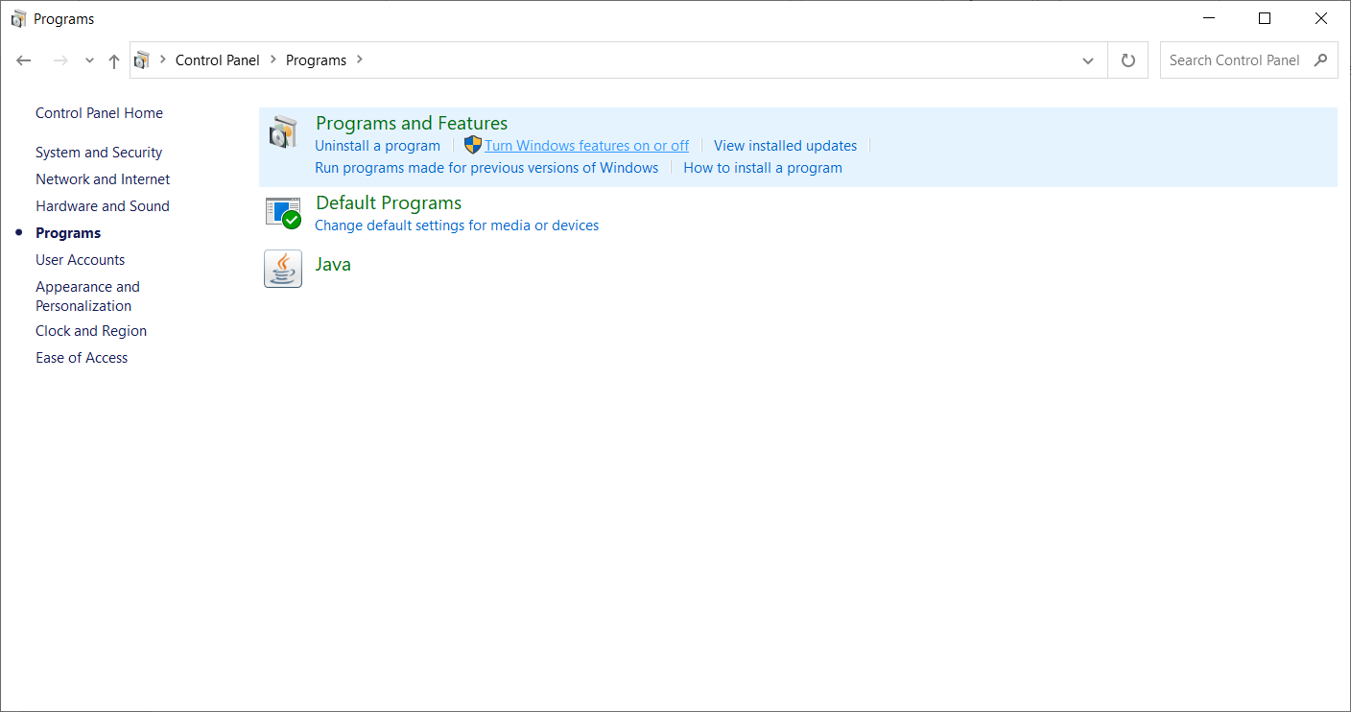
Click on “Turn Windows features on or off”

Slide 25
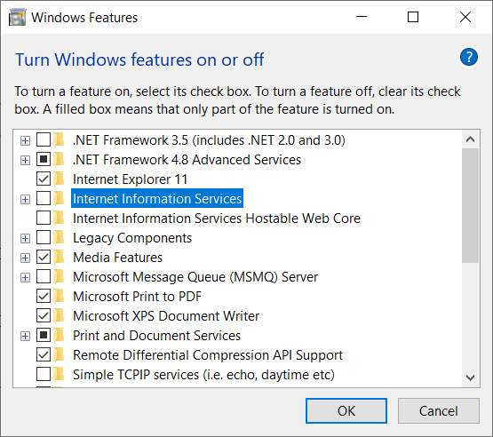

Slide 26
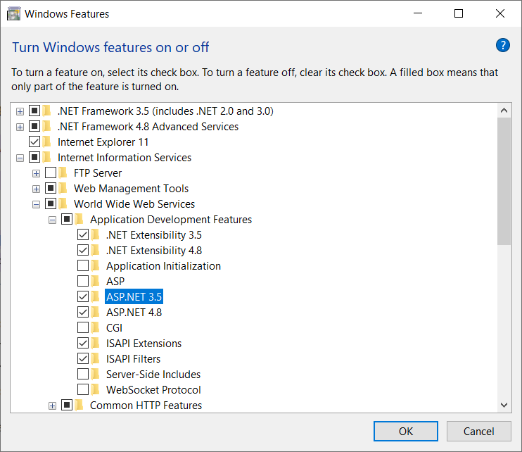
Expand the root-level item Internet Information Services, expand World Wide Web Services. Expand the Application Development Features node and click ASP.NET 4.5 to add the features that support ASP.NET. (If you installed .NET 3.5, select ASP.NET 3.5 also.)

Slide 27
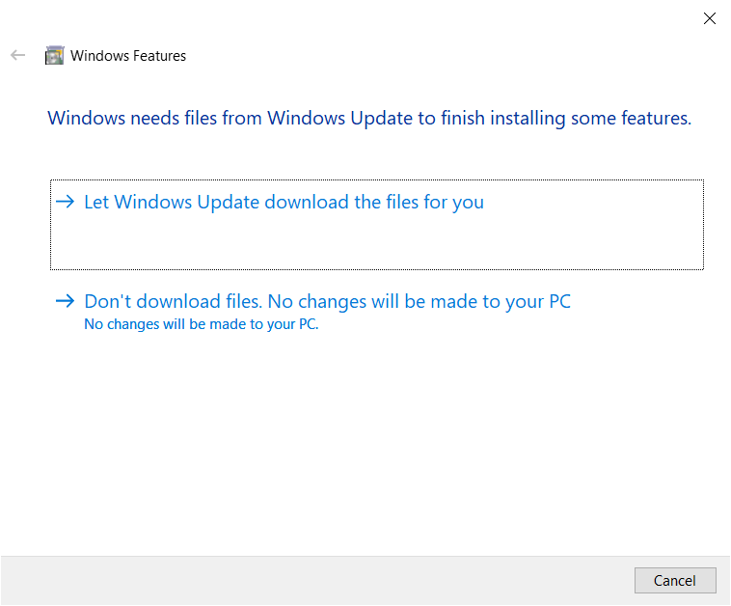
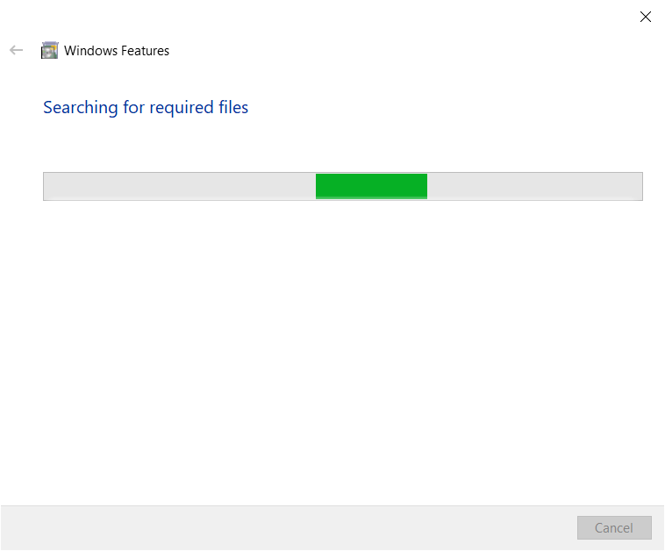

Slide 28
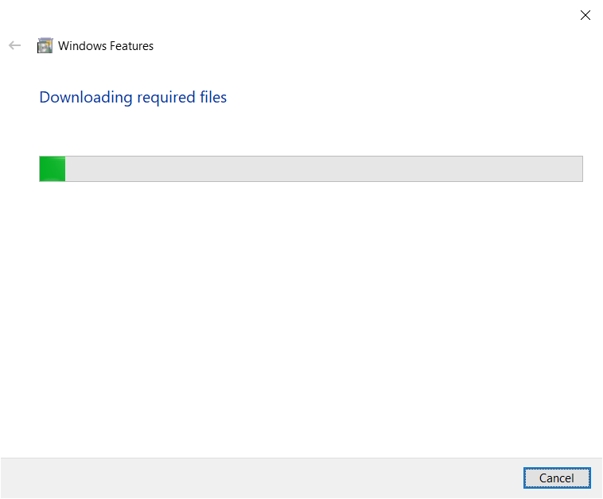

Slide 29
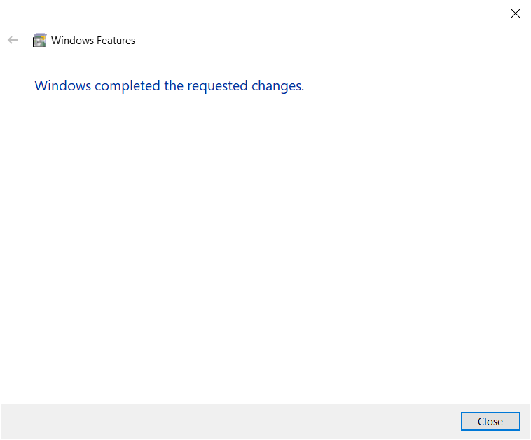

Slide 30
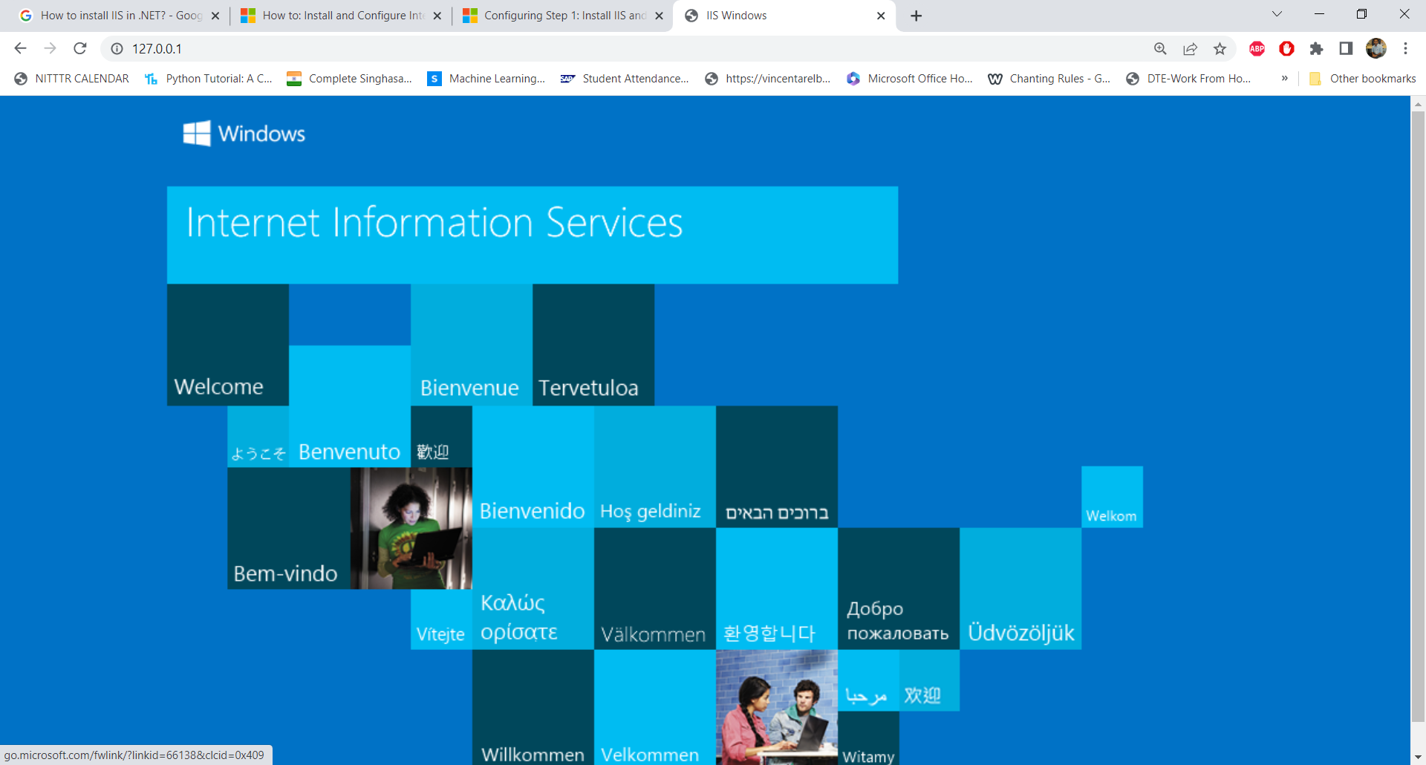
To verify that IIS installed successfully, type the following into a web browser:
http://localhost
The default IIS Welcome page is displayed.

Slide 31
References:
https://www.geeksforgeeks.org/introduction-to-visual-studio/
https://techmonitor.ai/what-is/what-is-visual-studio
https://learn.microsoft.com/en-us/iis/application-frameworks/scenario-build-an-aspnet-website-on-iis/configuring-step-1-install-iis-and-asp-net-modules
http://net-informations.com/faq/asp/iis.htm
https://www.codeproject.com/Articles/42724/Beginner-s-Guide-Exploring-IIS-6-0-With-ASP-NET

